Slide 1
HITU Smart Home
Expert System
GRADUATION PROJECT · JAVA
Secure & Smart Living Spaces — a rule-based system that decides the right action for your home.

Slide 2
Project Team
Team Members
Supervisor
Adham Al Amir Ahmed
Ahmed Abdelbasit Gharib
Dr. Mohamed Salah
HITU Smart Home Expert System · 2

Slide 3
About the Project
A desktop smart-home application where the user enters sensor readings and the expert system returns the recommended action with a clear explanation.
Climate
Lighting
Security
Fire
Temperature, presence, windows
Motion, time of day
House mode, motion
Smoke sensor and duration
HITU Smart Home Expert System · 3

Slide 4
Purpose and Goals
Automate smart-home decisions with transparent IF-THEN rules
Explain every decision so users understand why
Save energy and improve comfort and safety
Keep a per-user history of all actions in a database
Provide secure login and registration
HITU Smart Home Expert System · 4

Slide 5
Project Structure
common
climate · lighting
security · fire
uisytem
smarthomeexpertsystem
SmartSystemModule (abstract base) and DBConnection
Swing GUI: login, register, menu, system screens, history
Four rule-engine classes extending the base
Main class: splash screen, then login
HITU Smart Home Expert System · 5

Slide 6
Technologies Used
Java / OOP
Swing / NetBeans
JDBC
Oracle SQL
Core language, desktop application
GUI forms and event handling
Database connectivity with PreparedStatement
Oracle XE database, tables and queries
HITU Smart Home Expert System · 6

Slide 7
Expert System Rules
System | Inputs | Actions
Climate | Temperature, user present, window status | AC, heater, fan, curtains
Lighting | Motion, light status, day/night, idle minutes | Lights on/off, timer reset
Security | House mode (Home/Sleep/Away), motion | Siren and phone alert
Fire | Smoke sensor, duration ≥ 5 s | Alarm, notify, shut down climate
HITU Smart Home Expert System · 7

Slide 8
Object-Oriented Design
Abstraction
Inheritance
Polymorphism
Encapsulation
SmartSystemModule declares abstract evaluate(), plus act and exp fields
Climate, Lighting, Security and Fire systems extend the base class
Each system overrides evaluate() with its own rules
Private inputs set through constructors; printACT() and printEXP() expose results
HITU Smart Home Expert System · 8

Slide 9
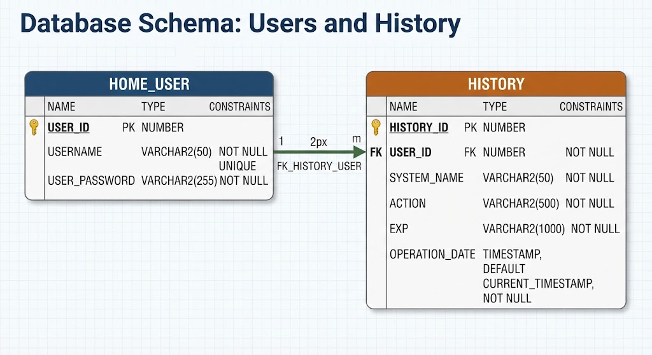
Database Schema
HITU Smart Home Expert System · 9

Slide 10
Application Flow
1 · Splash
2 · Login
3 · Menu
4 · Decide
5 · Save
Progress bar, then login
Register or sign in, validated against HOME_USER
Climate, Light, Security, Fire, History
Enter inputs; rules give action and explanation
Result stored in HISTORY via JDBC
HITU Smart Home Expert System · 10

Slide 11
Thank You
Adham Al Amir Ahmed · Ahmed Abdelbasit Gharib
Supervisor: Dr. Mohamed Salah
GitHub: [https://github.com/Adham-Al-Amir/HITU-Smart-Home-Expert-System]

